Slide 1
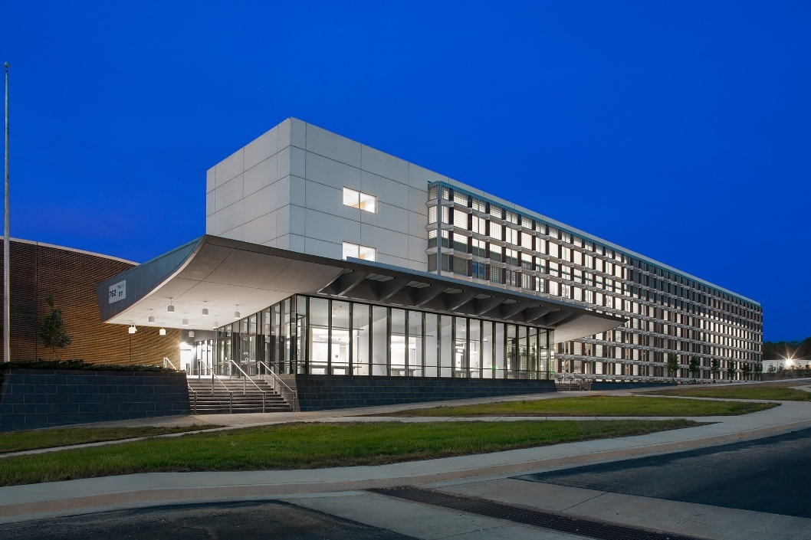
GTRI Cobb County Research Facility (CCRF)
South Campus Visitor Guide

Slide 2
Plan Your Visit: Clearance/Visit Request
Visitor Procedures
The following procedures shall be adhered to when visiting GTRI-CCRF facilities:
Guests must check in with the on-duty contract guard in Building 11.
All guests will have their identity verified via photo identification.
The on-duty contract guard will contact the GTRI person to be visited who will be responsible for their guests.
Representatives of the federal government, when acting in their official capacity as inspectors, investigators or auditors, may visit GTRI facilities without advance notification, provided these representatives present appropriate government credentials upon arrival.
All guests will be issued a badge as a form of identity to verify they have been properly vetted by the on-duty contract guard.
For Collateral-level visits, please submit your clearance/
visit request via DISS using SMO Code: 0KC83 (note, first character is the number 0) or
via fax to 404-407-8691.
Please provide the GTRI POC name and
phone number for the Technical POC.
Security POC: Steffany Trent
Security POC Phone: 404-407-8151
GTRI-CCRF Physical Address:
2001 Dixie Avenue
Smyrna, GA 30080
When you request to visit, please have the name and phone number of your GTRI point of contact available.
Contact the following for additional information regarding visit requests:
Research Security Help Desk
Phone: 404-407-6661
Email: rsdhelp@gtri.gatech.edu

Slide 3
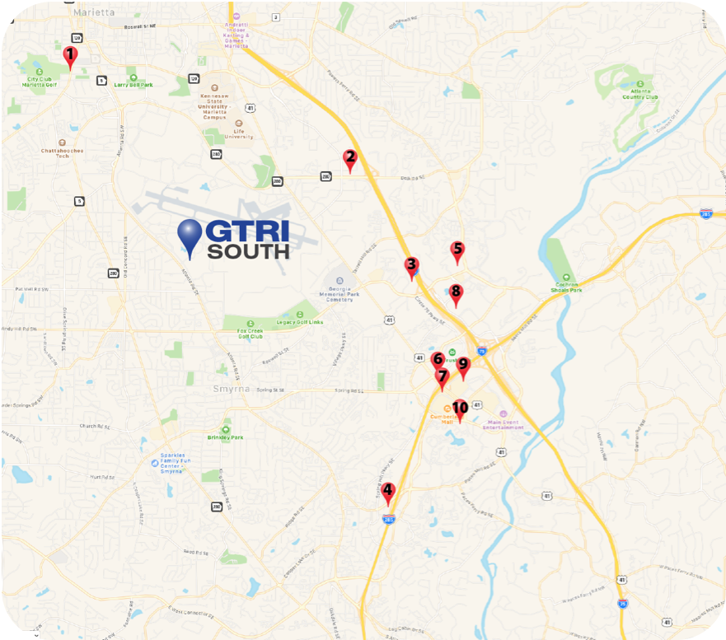
Plan Your Visit: Location and Lodging
GTRI’s Cobb County campus is located outside of Dobbins ARB, just 25 minutes north of Atlanta and only a few miles away from “The Battery” and Atlanta’s Truist Park, home of the Braves.
Our Physical Address:
2001 Dixie Avenue
Smyrna, GA 30080
Recommended Nearby Hotels
Hilton Atlanta/Marietta Hotel & Conference Center (4.3 mi)
500 Powder Springs St, Marietta, GA 30064
Phone: 770-427-2500
Hampton Inn and Suites Atlanta/Marietta (4.6 mi)
2136 Kingston Ct, Marietta, GA 30067
Phone: 678-460-1160
Courtyard By Marriott Atlanta Windy Hill/Ballpark (4.6 mi)
2045 S Park Place NW, Marietta, GA 30060
Phone: 770-955-3838
Fairfield Inn & Suites by Marriott Atlanta
Vinings/Galleria (5.2 mi)
2450 Paces Ferry Rd SE, Atlanta, GA 30339
Phone: 770-435-4500
Hyatt Regency Suites Atlanta Northwest (5.3 mi)
2999 Windy Hill Road SE, Marietta, GA 30067
Phone: 770-956-1234
Hampton Inn & Suites Atlanta-Galleria (5.4 mi)
2733 Circle 75 Pkwy, Atlanta, GA 30339
Phone: 770-955-111
Sheraton Suites Galleria-Atlanta (5.5 mi)
2844 Cobb Parkway SE, Atlanta, GA 30339
Phone: 770-955-3900
Atlanta Marriott Northwest at Galleria (5.7 mi)
200 Interstate North Pkwy, Atlanta, GA 30339
Phone: 770-952-790
Renaissance Atlanta Waverly Hotel &
Convention Center (5.7 mi)
2450 Galleria Parkway, Atlanta, GA 30339
Phone: 770-953-4500
Courtyard by Marriott Atlanta Cumberland/Galleria (5.8 mi)
3000 Cumberland Blvd SE, Atlanta, GA 30339
Phone: 770-952-2555

Slide 4
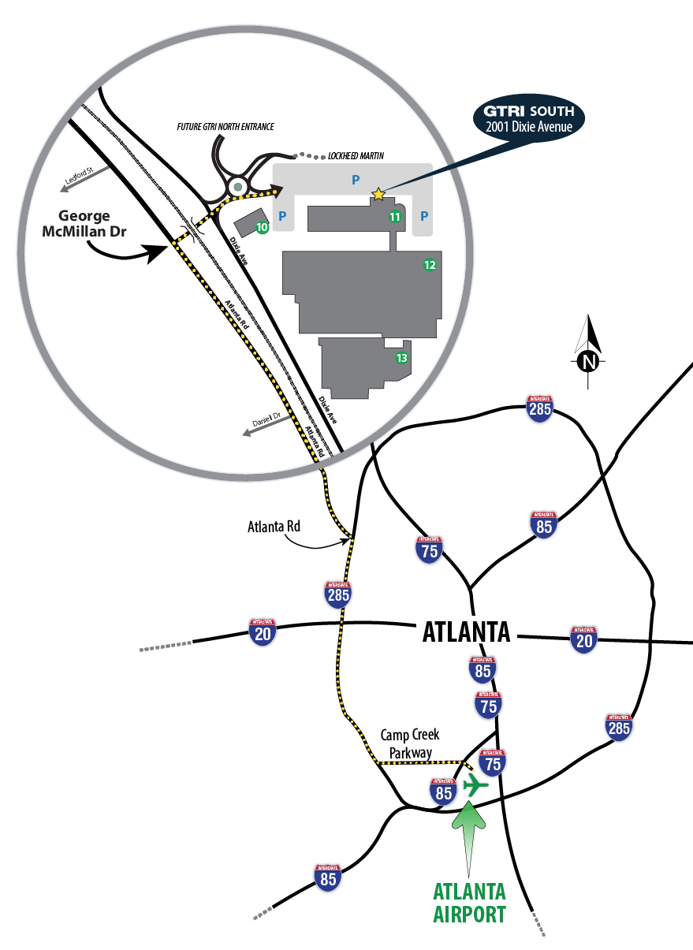
During Your Visit: Directions from ATL Airport
Exit Airport to Camp Creek Parkway
Approx. 3 miles, turn Right onto I-285 North
Approx. 13.2 miles, exit to Atlanta Rd
Turn left (north) onto Atlanta Road
Take Atlanta Road North to George McMillan Drive (on the RHS; about 0.3 mi after passing the Windy Hill Rd intersection)
Turn right at George McMillan Drive, will see Lockheed-Martin directly ahead (this turn goes below the train trestle)
Keep straight through first intersection (light is absent)
Enter roundabout and proceed to 1st exit on right
Continue to Building 11 (4-story building)
Park in Visitor Parking area at Building 11
Go to Building 11 lobby and check in with front desk guard
(See next page for detailed map of GTRI-CCRF SOUTH)
2001 Dixie Avenue SE
Smyrna, GA 30080
(Google Maps directions link)

Slide 5
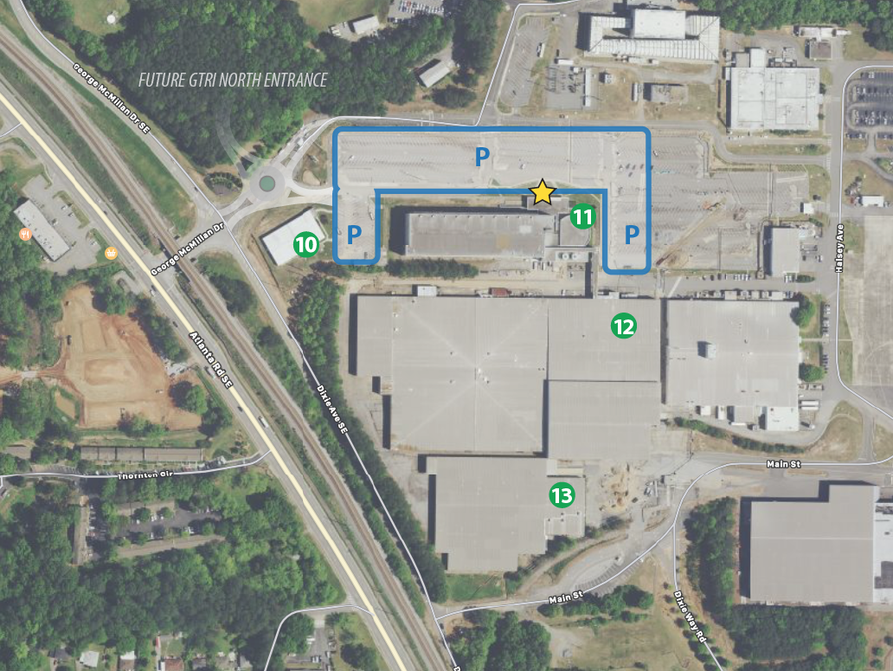
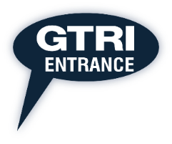
During Your Visit: Map & Parking
After entering the facility via the roundabout, proceed straight to the large glass building, Building 11
Parking anywhere in the blue outlined area is available free of charge. Reserved visitor parking spots are available as marked or first-come-first-serve in front of the building.
Enter Building 11 and proceed left of the guard desk for badging and sign-in.
Visitor Parking
Visitor Entrance

Slide 6
During Your Visit: Restaurants and Attractions
Restaurant Recommendations
Rev Coffee (coffee, breakfast pastries)
1680 Spring Rd SE B, Smyrna, GA 30080
Marietta Square Market (food hall with multiple quick options)
68 North Marietta Pkwy NW, Marietta, GA 30060
Creatwood Tavern & Rooftop (American)
1090 Windy Hill Rd SE #300, Smyrna, GA 30080
Old South Bar-B-Q (Barbecue)
601 Burbank Cir, Smyrna, GA 30080
Himilayan Kitchen (Tibetan; voted best dumplings)
1651 Roswell St Suite C, Smyrna, GA 30080
Events/Attractions
Andretti Indoor Karting & Games (go karting, arcade)
1255 Roswell Rd, Marietta, GA 30062
American Axes (axe throwing)
821 Livingston Ct suite g, Marietta, GA 30067
Kennesaw Mountain National Battlefield Park (hiking, outdoors)
900 Kennesaw Mountain Dr, Kennesaw, GA 30152
Punch Bowl Social (games, bowling, cocktails)
875 Battery Ave SE Ste 720, Atlanta, GA 30339
The Aviation History & Technology Center (air museum)
555 Perrin Rd, Marietta, GA 30060

